Slide 1
Robot Justification and Maintenance
IMSE/CIS 381
Industrial Robots
Robot Justification, Maintenance

Slide 2
Costs Associated with Robot Project
Investment costs
  Robot purchase cost
  Engineering costs
  Installation costs
  Special tooling
  Miscellaneous
Operating costs
  Direct labor cost
  Indirect labor cost
  Maintenance
  Utilities
  Training
Robot Justification, Maintenance

Slide 3
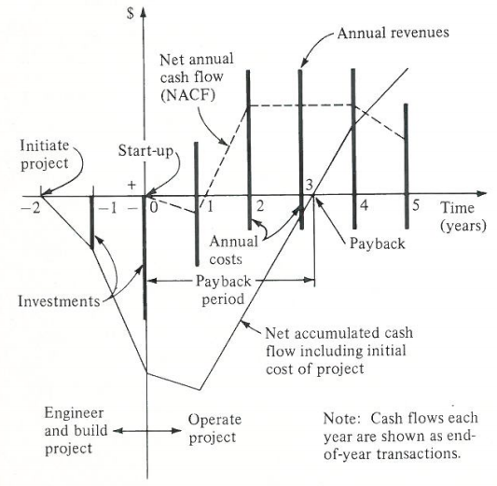
Life Cycle of Cash Flows in a Robot Investment Project
Net cash flow = revenues – operating cost
At the beginning of operations, startup problems limit the net cash flow
Payback period = the point at which investment is recovered
Robot Justification, Maintenance

Slide 4
Methods of Economic Analysis
Methods for analyzing investments and comparing investment alternatives
  Payback period method
  Equivalent uniform annual cost (EUAC) method
  Return on investment (ROI) method
Robot Justification, Maintenance

Slide 5
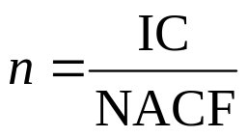
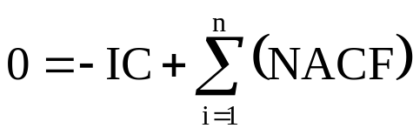
Payback Period Method
Assuming the net annual cash flows are equal from year to year:
where n = payback period
IC = the investment cost
NACF = the net annual cash flow
When NACFs vary from year to year:
Robot Justification, Maintenance

Slide 6
Equivalent Uniform Annual Cost Method
The EUAC method converts all present and future investments and cash flows into their equivalent uniform cash flows over the life of the project
It uses various interest factors associated with engineering economy calculations
Minimum Attractive Rate-of-Return (MARR)
  It is used as a criterion to decide whether a potential investment should be funded
  The interest factors for the MARR is used to make the EUAC conversions
EUAC = IC * (A/P, i, n)
EUAC: equivalent annual cost ($/yr)
IC: initial cost of the machine ($)
(A/P, i, n): capital recovery factor, i: interest rate, n: lifetime in years
(A/P, i, n) = i (1+i)^{n} / ((1+i)^{n} – 1)
If the sum of the EUACs is greater than 0, then the actual rate of return is greater than the MARR and hence the investment is attractive
Robot Justification, Maintenance

Slide 7
Example 1
Suppose the total investment cost is estimated to be $100,000 for a robot project. The total operating costs (labor, maintenance, and etc) are expected to be $20,000 per year, and the anticipated revenues are $65,000 per year. The robot project is expected to have a service life of 5 years.
(a) Determine the payback period that is expected of the investment
(b) Suppose the company uses a 30% MARR as a criterion for selecting its investment project, apply the EUAC method to assess the investment
Robot Justification, Maintenance

Slide 8
Return on Investment (ROI) Method
Determine the rate of return by equating the sum of EUAC to zero
If the rate or return is greater than the company’s MARR, then the investment is justified
In the previous example,
EUAC = -100,000(A/P, i, 5) + 65,000 – 20,000 = 0
Then, i = 0.35 which is greater than the MARR of 30%
Robot Justification, Maintenance

Slide 9
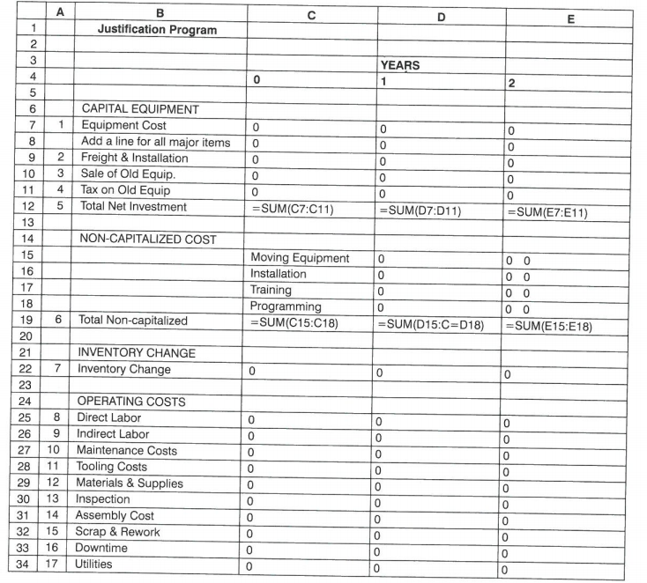
Justification Spreadsheet
Robot Justification, Maintenance

Slide 10
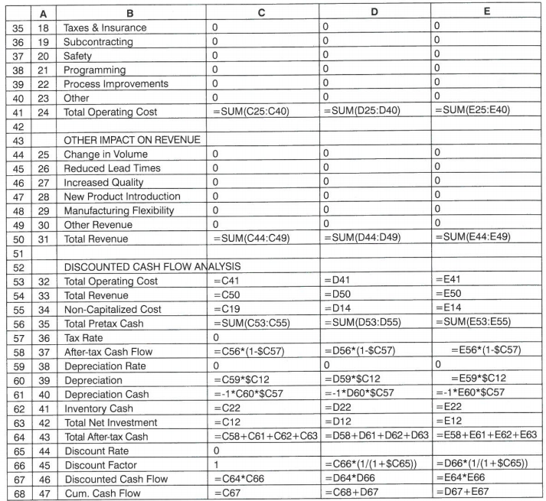
Justification Spreadsheet
Robot Justification, Maintenance

Slide 11
Robot Maintenance
Two types of maintenance activity
  Preventive maintenance (PM)
  - planned servicing of equipment at periodic intervals
  Emergency maintenance (EM)
  - involves the case when repairing a robot that malfunctions or breaks down during regular operation
EM is usually more expensive than PM as in most cases the regular production will have to be interrupted
PM on the other hand can be done more conveniently when the production equipment is not in regular operation
Robot Justification, Maintenance

Slide 12
Preventive Maintenance
Objective of PM
Service the equipment at periodic intervals to reduce the occurrence of emergency breakdowns
PM for robotics
  Checking, cleaning and replacing certain mechanical and electrical components of the robot at regular intervals
  Typical components that are subject to wear include O-rings, seals, bearings, bushings, and valves
Robot Justification, Maintenance

Slide 13
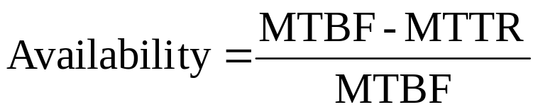
MTBF and MTTR
Mean Time Between Failure (MTBF)
MTBF indicates how long, on average, the machinery will operate between breakdowns
Mean Time To Repair (MTTR)
MTTR indicates how much time, on average, is spent repairing the robot for each breakdown
Availability – the proportion of time that the robot is available for operation
The effect of good PM is to increase Availability by increasing the MTBF and by reducing the MTTR for an emergency breakdown situations
Robot Justification, Maintenance

Slide 14
Predictive Maintenance
Maintenance based on prediction of failures using data analytics
The idea is to perform the maintenance when a failure is expected thereby reducing downtimes and maintenance cost
Big Data sources
  Data from robot internal sensors during robot operations
  Failure logs
Algorithm
  Statistics, Machine learning, data clustering, deep learning, neural network, etc
Robot Justification, Maintenance

